Slide 1
#06 RPC & REST
Client/Server Computing and Web Technologies

Slide 2
Introduction
Remote Procedure Call (RPC) is a high-level model for client-sever communication.
It provides the programmers with a familiar mechanism for building distributed systems.
Examples: File service, Authentication service.

Slide 3
RPC Model
client
server
Call procedure and wait for reply
request
Receive request and start process execution
Send reply and wait for next execution
reply
Resume execution
Blocking state
Executing state

Slide 4
Characteristics
The called procedure is in another process which may reside in another machine.
The processes do not share address space.
Passing of parameters by reference and passing pointer values are not allowed.
Parameters are passed by values.
The called remote procedure executes within the environment of the server process.
The called procedure does not have access to the calling procedure's environment.
No message passing or I/O at all is visible to the programmer.

Slide 5
Features
Simple call syntax
Familiar semantics
Well defined interface
Ease of use
Efficient
Can communicate between processes on the same machine or different machines

Slide 6
Limitations
Parameters passed by values only and pointer values are not allowed.
Speed: remote procedure calling (and return) time (i.e., overheads) can be significantly (1 - 3 orders of magnitude) slower than that for local procedure.
Failure: RPC is more vulnerable to failure (since it involves communication system, another machine and another process).
The programmer should be aware of the call semantics, i.e. programs that make use of RPC must have the capability of handling errors that cannot occur in local procedure calls.

Slide 7
Design Issues
Exception handling
Necessary because of possibility of network and nodes failures;
RPC uses return value to indicate errors;
Transparency
Syntactic → achievable, exactly the same syntax as a local procedure call;
Semantic → impossible because of RPC limitation: failure (similar but not exactly the same);
Notes:
Transparency: http://hubpages.com/education/Remote-Procedure-Calls-RPC

Slide 8
Design Issues
Delivery guarantees
Retry request message: whether to retransmit the request message until either a reply or the server is assumed to have failed;
Duplicate filtering : when retransmission are used, whether to filter out duplicates at the server;
Retransmission of replies: whether to keep a history of reply messages to enable lost replies to be retransmitted without re-executing the server operations.

Slide 9
RPC Components
Client
Client stub: has same function signature as callee()
Allows same caller() code to be used for LPC and RPC
Communication Module: Forwards requests and replies to appropriate hosts
Server
Dispatcher: Selects which server stub to forward request to
Server stub: calls callee(), allows it to return a value
int caller()
Client stub
P1
(“client”)
Communication module
Communication module
Dispatcher
Server stub
P2
(“server”)
int callee()

Slide 10
Generating Code
Programmer only writes code for caller function and callee function
Code for remaining components all generated automatically from function signatures (or object interfaces in Object-based languages)
E.g., Sun RPC system: Sun XDR interface representation fed into rpcgen compiler
These components together part of a Middleware system
E.g., CORBA (Common Object Request Brokerage Architecture)
E.g., Sun RPC
E.g., Java RMI

Slide 11
Marshalling
Different architectures use different ways of representing data
Caller (and callee) process uses its own platform-dependent way of storing data
Middleware has a common data representation (CDR) which is platform-independent
Caller process converts arguments into CDR format
Called “Marshalling”
Callee process extracts arguments from message into its own platform-dependent format
Called “Unmarshalling”
Return values are marshalled on callee process and unmarshalled at caller process

Slide 12
JSON-RPC
Remote procedure call protocol encoded in JSON.
It is a very simple protocol (and very similar to XML-RPC), defining only a handful of data types and commands.
Allows for notifications (data sent to the server that does not require a response)
Multiple calls to be sent to the server which may be answered out of order.
Invoked by sending a request to a remote service using HTTP or a TCP/IP socket (starting with version 2.0).

Slide 13
Example: adding
var rpc = require('json-rpc2');
var server = rpc.Server.$create();
function add(args, opt, callback) {
callback(null, args[0] + args[1]);
}
server.expose('add', add);
server.listen(8000, 'localhost');
server.js
var rpc = require('json-rpc2');
var client = rpc.Client.$create(8000,
'localhost');
// Call add function on the server
client.call('add', [1, 2],
function(err, result) {
console.log('1 + 2 = ' + result);
}
);
client.js
>> npm install json-rpc2
Reference: https://github.com/pocesar/node-jsonrpc2
https://github.com/justmoon/node-jsonrpc2
Notes:
https://github.com/justmoon/node-jsonrpc2
callback(null, .. ) null for error
http://stackoverflow.com/questions/22518978/nodejs-callback-with-null-as-first-argument

Slide 14
REST and HTTP
The motivation for REST was to capture the characteristics of the Web which made the Web successful.
URI Addressable resources
HTTP Protocol
Make a Request – Receive Response – Display Response
Exploits the use of the HTTP protocol beyond HTTP POST and HTTP GET
HTTP PUT, HTTP DELETE
Notes:
RPC vs. REST (very similar)
RPC: function or module oriented [e.g., add(), get(), calculate() , http://server/someOperation?id=3 ]
REST: Resource Oriented (by using HTTP verbs to provide REpresentational State Transfer) [e.g., addUser(), getUser(), http://server/someResource/3]
http://apihandyman.io/do-you-really-know-why-you-prefer-rest-over-rpc/
As a programming approach, REST is a lightweight alternative to Web Services and RPC. Much like Web Services, a REST service is:
Platform-independent (you don't care if the server is Unix, the client is a Mac, or anything else),
Language-independent (C# can talk to Java, etc.),
Standards-based (runs on top of HTTP), and
Can easily be used in the presence of firewalls.

Slide 15
Main Concepts
Nouns (Resources) unconstrained i.e., http://example.com/employees/12345
REST
Verbs constrained i.e., GET
Representations constrained i.e., XML

Slide 16
Resources
REpresentative State Transfer
The key abstraction of information in REST is a resource.
A resource is a conceptual mapping to a set of entities
Any information that can be named can be a resource
a document or image
a temporal service (e.g. "today's weather in Los Angeles")
a collection of other resources
a non-virtual object (e.g. a person)
Represented with a global identifier (URI in HTTP)
http://www.boeing.com/aircraft/747

Slide 17
Verbs
Represent the actions to be performed on resources
HTTP GET
HTTP POST
HTTP PUT
HTTP DELETE

Slide 18
HTTP GET
How clients ask for the information they seek.
Issuing a GET request transfers the data from the server to the client in some representation
GET http://localhost/books
Retrieve all books
GET http://localhost/books/ISBN-0011021
Retrieve book identified with ISBN-0011021
GET http://localhost/books/ISBN-0011021/authors
Retrieve authors for book identified with ISBN-0011021

Slide 19
HTTP PUT, POST, DELETE
POST http://localhost/books/
Content: {title, authors[], …}
Creates a new book with given properties
PUT http://localhost/books/isbn-111
Content: {isbn, title, authors[], …}
Updates book identified by isbn-111 with submitted properties
DELETE http://localhost/books/ISBN-0011
Delete book identified by ISBN-0011

Slide 20
Representations
How data is represented or returned to the client for presentation.
Two main formats:
JavaScript Object Notation (JSON)
XML
It is common to have multiple representations of the same data

Slide 21
Why is it called "Representational State Transfer"?
Resource
Client
http://www.boeing.com/aircraft/747
Fuel requirements
Maintenance schedule
...
Boeing747.html
The Client references a Web resource using a URL. A representation of the resource is returned (in this case as an HTML document).
The representation (e.g., Boeing747.html) places the client application in a state. The result of the client traversing a hyperlink in Boeing747.html is another resource accessed. The new representation places the client application into yet another state. Thus, the client application changes (transfers) state with each resource representation --> Representation State Transfer!
Notes:
Representation = resource format (html, json, xml)
State = Noun (json, data, document, image)
Transfer = send from server to client

Slide 22
Architecture Style
Request
(XML doc)
HTTP GET
URL 1
doGet()
Response
(XML doc)
HTTP Response
doPost(id)
Request
(XML doc)
HTTP POST
URL 1
REST Engine
(locate resource and generate response)
Web/Proxy Server
Response
(JSON doc)
HTTP Response
doDelete()
PO
(XML doc)
HTTP DELETE
URL 1
Response
(TEXT doc)
HTTP Response

Slide 23
Example: REST for bears
Route | HTTP Verb | Description
/api/bears | GET | Get all the bears.
/api/bears | POST | Create a bear.
/api/bears/:bear_id | GET | Get a single bear.
/api/bears/:bear_id | PUT | Update a bear with new info.
/api/bears/:bear_id | DELETE | Delete a bear.

Slide 24
Example: Create a bear
var express = require('express');
var app = express();
var router = express.Router();
var bodyParser = require('body-parser');
var bears = [];
router.route('/bears')
.post(function(req, res) {
var bear = {};
bear.name = req.body.name;
bears.push(bear);
res.json({ message: 'Bear created!' });
});
// all of our routes will be prefixed with /api
app.use('/api', bodyParser.json(), router);
app.listen(8000);
Notes:
Router benefit: can be group route paths.
Express instance can create several routers.
var router1 = express.Router();
var router2 = express.Router();

Slide 25
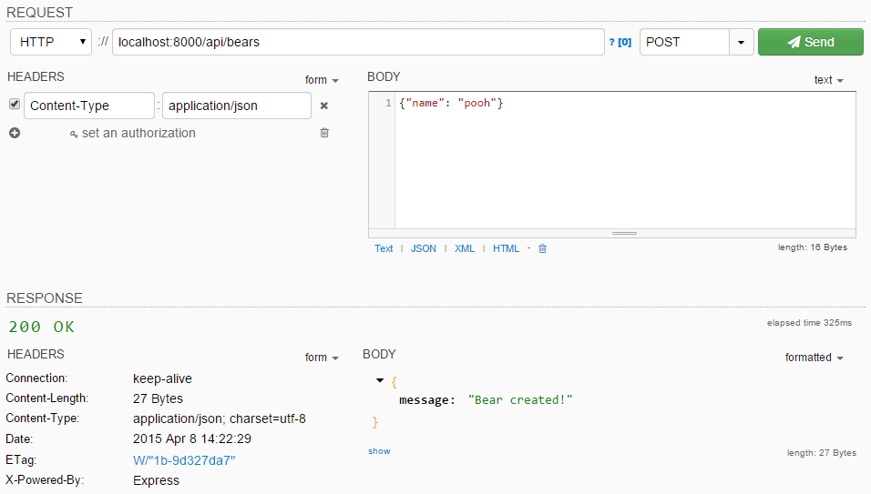
Try REST API
Chrome plugins with REST clients functionality are available. e.g., Postman, DHC

Slide 26
Restful - React

Slide 27
Get all bears (1)
import React, { Component } from 'react'; import axios from 'axios'; import _ from 'lodash'; const URL = 'http://localhost/api/bears'; class Bear extends Component { constructor(props){ super(props) this.state = { data: {} } } componentDidMount() { axios.get(URL) .then(response => { this.setState({data : response.data}) console.log(response.data) } ) } ...

Slide 28
Get all bears (2)
from lodash
renderBears() { return _.map(this.state.data, bear => { return ( <li className="list-group-item" key={bear.id}> {bear.id+1}. {bear.name}, {bear.weight} </li> ) }) } render() { return ( <div> <h2> Bear Profile</h2> <ul className="list-group"> {this.renderBears()} </ul> </div> ); } }

Slide 29
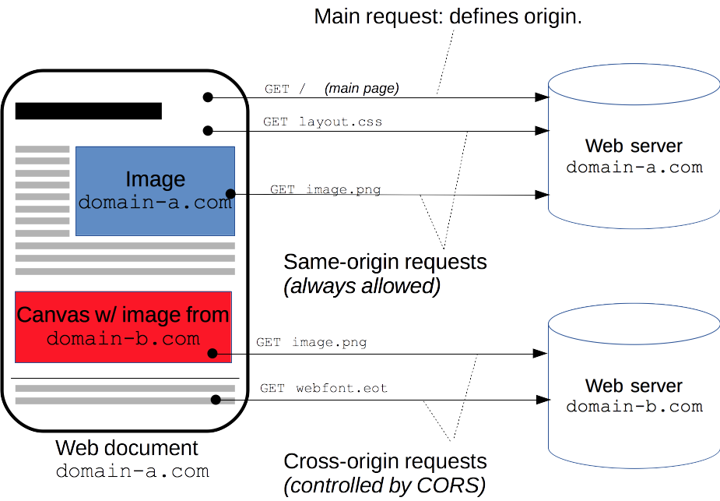
Cross-Origin Resource Sharing (CORS)
Allow APIs to be called from different domains
npm install cors
var cors = require('cors') var app = express() app.use(cors())

Slide 30
Axios: Post and Delete example
axios.post('http://localhost/api/bears', { name: 'Fred', weight: 123 }) .then( (response) => { console.log('Create a bear: ' + response); }) .catch( (error) => { console.log(error); });
axios.delete('http://localhost/api/bears/5') .then( (response) => { console.log('Delete:' + response) })

Slide 31
React - Redux - Router

Slide 32
Redux
Redux is a predictable state container for JavaScript apps.
Write applications that behave consistently, run in different environments (client, server, and native), and are easy to test.
Redux divides a component into several types:
Components (View)
Actions (Event)
Reducers (Data)
Reference: https://en.wikipedia.org/wiki/Redux_(JavaScript_library)

Slide 33
Component
components/bear_index.js
class BearIndex extends Component { componentDidMount() { this.props.fetchBears() } renderBears() { return _.map(this.props.bears, bear => { return ( <li className="list-group-item" key={bear.id}> {bear.id+1}. {bear.name}, {bear.weight} </li> ) }) } render() { return ( <div> <h2> Bear Profile</h2> <ul className="list-group"> {this.renderBears()} </ul> </div> ); } } function mapStateToProps(state) { return { bears: state.bears}; } export default connect(mapStateToProps, {fetchBears} )(BearIndex);

Slide 34
Actions
actions/index.js
import axios from 'axios'; export const FETCH_BEARS = 'fetch_bears'; const ROOT_URL = 'http://localhost/api/bears'; export function fetchBears() { const request = axios.get(ROOT_URL); return { type: FETCH_BEARS, payload: request }; }

Slide 35
Reducers
reducers/index.js
import { combineReducers } from 'redux'; // import { reducer as formReducer } from 'redux-form'; import BearsReducer from './reducer_bears'; const rootReducer = combineReducers({ bears: BearsReducer }); export default rootReducer;

Slide 36
React-Redux
View
components/
bear_index.js
componentDidMount()
Re Render() View
ActionCreator
actions/index.js
MapStateToProps
Action
fetchBears()
Got promises (bear)
Store
Middleware
applyMiddleware
(promise)(createStore)
Select promise
Reducer
reducers/index.js
RootReducer
BearReducer

Slide 37
Reducer
reducers/bear_reducer.js
import _ from 'lodash'; import {FETCH_BEARS } from '../actions'; export default function (state = {}, action) { switch(action.type) { case FETCH_BEARS: return _.mapKeys(action.payload.data,'id'); default: return state; } }

Slide 38
Main page - Router
import React, { Component } from 'react'; import { Provider } from 'react-redux'; import { createStore, applyMiddleware } from 'redux'; import { BrowserRouter, Route, Switch } from 'react-router-dom' import promise from 'redux-promise'; import reducers from './reducers'; import BearIndex from './components/bear_index'; const createStoreWithMiddleware = applyMiddleware(promise)(createStore);
Install more libraries

Slide 39
Main page - Router
class AppBear extends Component { render() { return ( <Provider store={createStoreWithMiddleware(reducers)}> <BrowserRouter> <div> <Switch> <Route path="/" component={BearIndex} /> </Switch> </div> </BrowserRouter> </Provider> ); } } export default AppBear;
Map path to a component

Slide 40
References
"Advanced Operating Systems: RPC", Ajay Katangur
"RPCs and Concurrency Control", Indranil Gupta, 2014
"JSON-RPC", http://en.wikipedia.org/wiki/JSON-RPC
"Node-jsonrpc2", https://github.com/pocesar/node-jsonrpc2
"Representational State Transfer (REST): Representing Information in Web 2.0 Applications", Emilio F Zegarra
"Build a RESTful API Using Node and Express 4", https://scotch.io/tutorials/build-a-restful-api-using-node-and-express-4
"Express Routing", http://expressjs.com/guide/routing.html

